Slide 1
DIR and FAT table
-Srinivas Garapati

Slide 2
Operating System: Ubuntu
Used Oracle VM virtual box for Ubuntu
Programming Language: Java
IDE: Eclipse in Windows
Data Extraction Tool: dd

Slide 3
Master Boot Record :
Stores Partition meta data.
01
Boot Sector :
Has necessary attributes to go to root directory.
02
Root Directory :
Has the file entries details that are in the partition.
03
File Data :
File data starts from this offset.
04

Slide 4
Boot Sector Data
Boot sector is present in the first sector of a volume record or partition.
We were given a FAT32 partition file image – labsda1.img.
Used dd tool to extract the boot sector data.
Used ArrayList to store the bytes.

Slide 5
Labsda1.img
This image was made a FAT32 partition.
This image folder data were first zeroed. Making all the bits in the data to zero.
This image initially were written with three text files, two small and one large file that would fill one entire cluster and exceed to know the behavior when deleted.
Then we had overwritten the large file with a small file to know the FAT32 file system behavior when files are removed.
The three file names:
Number1
NutterButter
Number2

Slide 6
dd commands Used to Extract the boot sector data:
dd command:
sudo dd if=/home/srinivas/labsda1.img of=labsda count=512 bs=1
dd to save to output text file:
xxd labsda > bootsector.txt
Used a function named process in java that would call the system calls from the java program.
This would avoid the burden of providing the dd command externally.

Slide 7
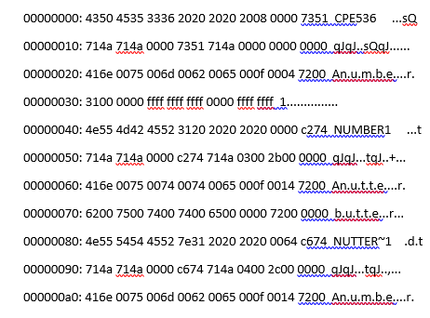
Extracting the hex data:
Data in hex
ASCII data
Offsets in hex
After I got the data saved into a text file my next challenge was to extract the hex data and separate the offset and ascii data from it.
I first created a Scanner, in java it is used to take input from the user.
Using scanner I parsed through each line and saved that line into a string and extracted only the hex data.
Saved the data into an ArrayList since we do not know the size of the data to be stored before.

Slide 8
Attributes needed to find root directory
Number of Sectors per Cluster
Number of Reserved Sectors
Number of FAT Copies
Number of Sectors per FAT
Root Cluster Number
First Data Sector in bytes
First Sector of Cluster

Slide 9
Bytes to skip to go to root directory
Calculated the attribute values needed in decimal.
Root directory starts after the FAT table copies and reserved bits.
So have to calculate the bytes that make up the FAT and reserved bytes:
firstDataSector=(reserved_Sectors+(num_Fatcopy*num_sectors_perFAT))*bytes_perSector
firstsector_Cluster= ((cluster_Num-2)*sectors_perCluster)+firstDataSector;

Slide 10
Values Obtained
Bytes per sector : 512 || Hex Value : 0200
Number of Sectors per Cluster : 1 || Hex Value : 01
Number of Reserved Sectors : 32 || Hex Value : 0020
Number of FAT Copies : 2 || Hex Value : 02
Number of Sectors per FAT : 520 || Hex Value : 00000208
Root Cluster Number : 2 || Hex Value : 00000002
First Data Sector in bytes : 548864 || Hex Value : 86000
First Sector of Cluster : 548864 || Hex Value : 86000
So, the root directory can be found at 86000 offset in the data.

Slide 11
dd to skip to root directory
dd to skip root directory:
sudo dd if=/home/srinivas/labsda1.img of=labsdaroot skip=1072 count=1
Save to text file
xxd labsdaroot > rootD.txt
Converted the hex data to String format and dates from hex to decimal to binary to decimal.

Slide 12
Parsed the root directory :
Attributes found in root directory:
File name
File Extension is
File attribute
Reserved root bytes
Last Updated Time
Last Updated Date
Starting Cluster Number
File Size

Slide 13
Directory Name found in data
Directory name is : CPE536 || Hex value is : 4350453533362020
Directory Extension is : || Hex value : 202020
This is the archive flag. This can be set and cleared by the programmer or user
File attribute : || Hex value : 20
Reserved root bytes :

Slide 14
File 1
File name is : NUMBER1 || Hex value : 4e554d4245523120
File Extension is : || Hex value : 202020
This is the archive flag. This can be set and cleared by the programmer or user
File attribute : || Hex value : 20
Reserved root bytes :
Last Updated Time - 14:35:4
Last Updated Date - 3:1:2017
Starting Cluster Number : 3 || Hex value : 0003
File Size: 43 bytes

Slide 15
File 2
File name is : NUTTER~1 || Hex value : 4e55545445527e31
File Extension is : 1 || Hex value : 312020
This is the archive flag. This can be set and cleared by the programmer or user
File attribute : || Hex value : 20
Reserved root bytes :
Last Updated Time - 14:35:12
Last Updated Date - 3:1:2017
Starting Cluster Number : 4 || Hex value : 0004
File Size: 44 bytes

Slide 16
File 3
File name is : NUMBER2 || Hex value : 4e554d4245523220
File Extension is : || Hex value : 202020
This is the archive flag. This can be set and cleared by the programmer or user
File attribute : || Hex value : 20
Reserved root bytes :
Last Updated Time - 14:43:4
Last Updated Date - 3:1:2017
Starting Cluster Number : 28 || Hex value : 001c
File Size: 54 bytes

Slide 17
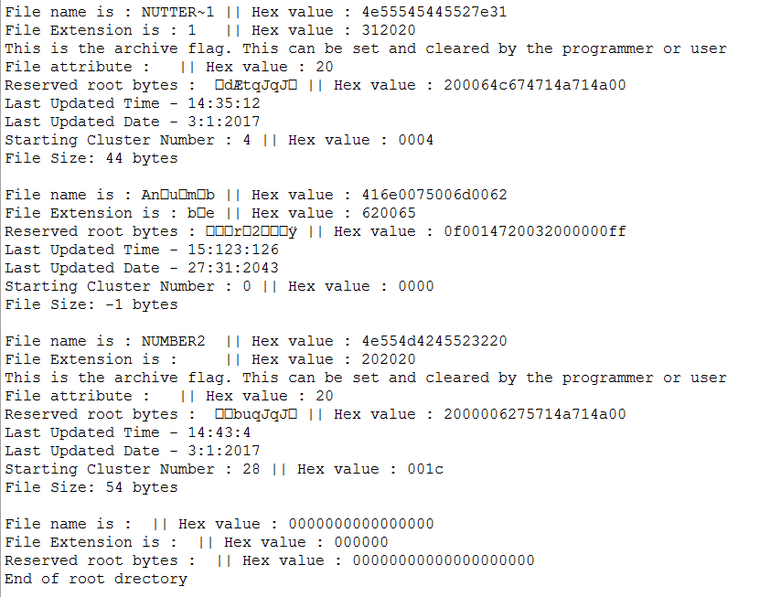
Point where root directory Ends…
I have parsed the root directory only until the point where there are no more files.
I have stopped at a point where the data produces all zeroes in the 32 bit attribute list of root directory.

Slide 18
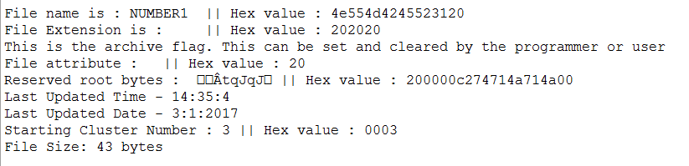
Where the file data starts?
Once the root directory is read the first file cluster number is given in the data extracted so we can skip to the cluster number retrieved.
For example for file 1 the cluster number was 3 so it starts from the next cluster of root directory since root directory is at cluster number 2.

Slide 19
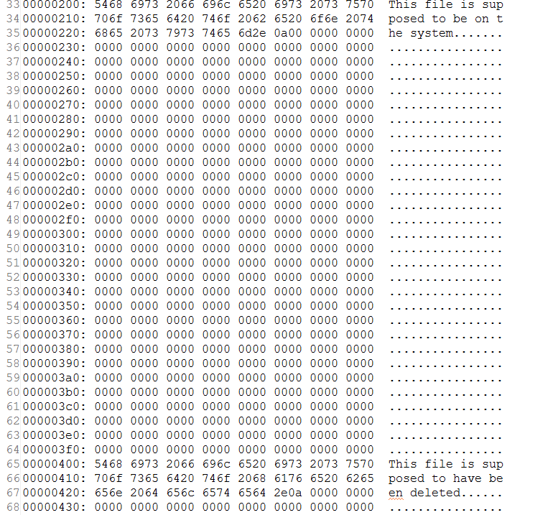
Cluster where file data starts….
File 1
File 2

